Slide 1
Outline
Introduction
Firewall design principles
Firewall characteristics
What firewalls do?
What firewalls cannot do?
Types of firewalls
references

Slide 2
Firewall

Slide 3
Introduction
A firewall : Acts as a security gateway between two networks-Usually between trusted and untrusted networks (such as between a corporate network and the Internet)
Tracks and controls network communications Decides whether to pass, reject, encrypt, or log communications (Access Control)
Is hardware, software, or a combination of both.
used to prevent unauthorized programs or Internet users from accessing a private network and/or a single computer.
A firewall sits at the junction point or gateway between the two networks, usually a private network and a public network such as the Internet.

Slide 4
Rules Determine
INTERNET
My PC
Secure
Private
Network
Firewall

Slide 5
Hardware vs. Software Firewalls
Hardware Firewalls
Protect an entire network
Implemented on the router level
Usually more expensive, harder to configure
Software Firewalls
Protect a single computer
Usually less expensive, easier to configure

Slide 6
Firewall Design Principles
The firewall is inserted between the premises network and the Internet
Aims:
Establish a controlled link
Protect the premises network from Internet-based attacks
Provide a single choke point

Slide 7
Firewall Characteristics
Design goals:
All traffic from inside to outside must pass through the firewall .
Only authorized traffic (defined by the local security police) will be allowed to pass
The firewall itself is immune to penetration (use of trusted system with a secure operating system)

Slide 8
Firewall Characteristics
Four general techniques:
Service control
Determines the types of Internet services that can be accessed, inbound or outbound
Direction control
Determines the direction in which particular service requests are allowed to flow
User control
Controls access to a service according to which user is attempting to access it
Behavior control
Controls how particular services are used (e.g. filter e-mail)

Slide 9
What Firewalls Do
Positive Effects
Negative Effects

Slide 10
Positive Effects
User authentication.
Firewalls can be configured to require user authentication. This allows network administrators to control ,track specific user activity.
Auditing and logging.
By configuring a firewall to log and audit activity, information may be kept and analyzed at a later date.

Slide 11
Anti-Spoofing - Detecting when the source of the network traffic is being "spoofed", i.e., when an individual attempting to access a blocked service alters the source address in the message so that the traffic is allowed.
Network Address Translation (NAT) - Changing the network addresses of devices on any side of the firewall to hide their true addresses from devices on other sides. There are two ways NAT is performed:
One-to-One - where each true address is translated to a unique translated address.
Many-to-One - where all true addresses are translated to a single address, usually that of the firewall.

Slide 12
Negative Effects
Although firewall solutions provide many benefits, negative effects may also be experienced.
Traffic bottlenecks. By forcing all network traffic to pass through the firewall, there is a greater chance that the network will become congested.
Single point of failure. In most configurations where firewalls are the only link between networks, if they are not configured correctly or are unavailable, no traffic will be allowed through.
Increased management responsibilities. A firewall often adds to network management responsibilities and makes network troubleshooting more complex.

Slide 13
What Firewalls Cannot Do
Do Firewalls Prevent Viruses and Trojans? NO!! A firewall can only prevent a virus or Trojan from accessing the internet while on your machine
95% of all viruses and Trojans are received via e-mail, through file sharing or through direct download of a malicious program
Firewalls can't prevent this -- only a good anti-virus software program can however , once installed on your PC, many viruses and Trojans "call home" using the internet to the hacker that designed it
This lets the hacker activate the Trojan and he/she can now use your PC for his/her own purposes
A firewall can block the call home and can alert you if there is suspicious behavior taking place on your system

Slide 14
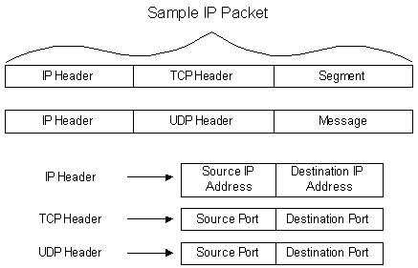
Types of Firewalls
Three common types of Firewalls:
Packet-filtering routers
Circuit-level gateways
Application-level gateways
Basic TCP/IP Flow review

Slide 15
Packet Filtering Firewall
Applies a set of rules to each incoming IP packet and then forwards or discards the packet
Filter packets going in both directions
The packet filter is typically set up as a list of rules based on matches to fields in the IP or TCP header
Two default policies (discard or forward)

Slide 16
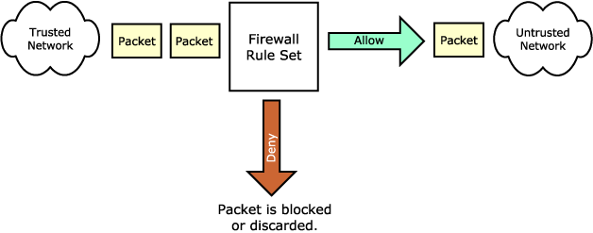

Slide 17
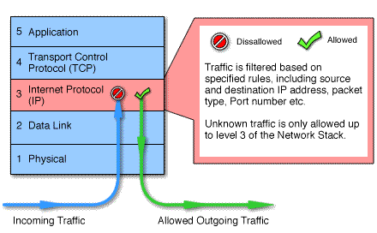
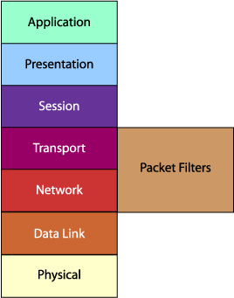
A packet filtering firewall is often called a network layer firewall because the filtering is primarily done at the network layer (layer three) or the transport layer (layer four) of the OSI reference model.

Slide 18
Packet filtering rules or filters can be configured to allow or deny traffic based on one or more of the following variables:
Source IP address
Destination IP address
Protocol type (TCP/UDP)
Source port
Destination port

Slide 19
advantages:
Packet filtering is typically faster than other packet screening methods. Because packet filtering is done at the lower levels of the OSI model, the time it takes to process a packet is much quicker.
Packet filtering firewalls can be implemented transparently. They typically require no additional configuration for clients.
Packet filtering firewalls are typically less expensive. Many hardware devices and software packages have packet filtering features included as part of their standard package.
Disadvantages:
Difficulty of setting up packet filter rules
Lack of Authentication

Slide 20
Circuit-level Gateway
Unlike a packet filtering firewall, a circuit-level gateway does not examine individual packets. Instead, circuit-level gateways monitor TCP or UDP sessions.
The main difference between packet filtering and this is that it validates
TCP and UDP sessions before opening a connection through the firewall.
Once a session has been established, it leaves the port open to allow all other packets belonging to that session to pass. The port is closed when the session is terminated.
circuit-level gateways operate at the transport layer (layer 4) and session layer of the OSI model.

Slide 21
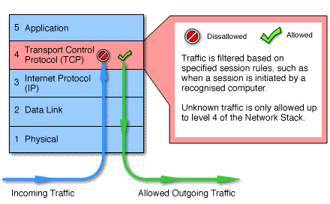

Slide 22
The firewall maintains a virtual circuit table, which stores the connection details of the successful connections.
Advantages-
More secure than packet filter firewalls.
Faster than application level firewalls.
Disadvantages-
Only detect one transport layer protocol-TCP.
Cannot perform security checks on higher level protocols.

Slide 23

Application-level Gateway
Also called proxy server
Gateway sits between user on inside and server on outside. Instead of talking directly, user and server talk through proxy.
This type of firewall operates at the application level of the OSI model. For source and destination endpoints to be able to communicate with each other, a proxy service must be implemented for each application protocol.

Slide 24

Advantages-
Allow the network administrator to have more control over traffic passing through the firewall. They can permit or deny specific applications or specific features of an application.
Higher security than packet filters

Slide 25
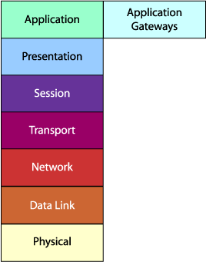
Disadvantages-
Additional processing overhead on each connection (gateway as splice point)
Not all services have proxied versions.
May need different proxy server for each service.

Slide 26
References-
Behrouz A. Forouzan, “Cryptography and Network Security”, McGraw-Hill publication.
William Stallings , “Cryptography and Network Security: Principles and Standards”, Prentice Hall India.

Slide 27
Thank you

